Slide 1
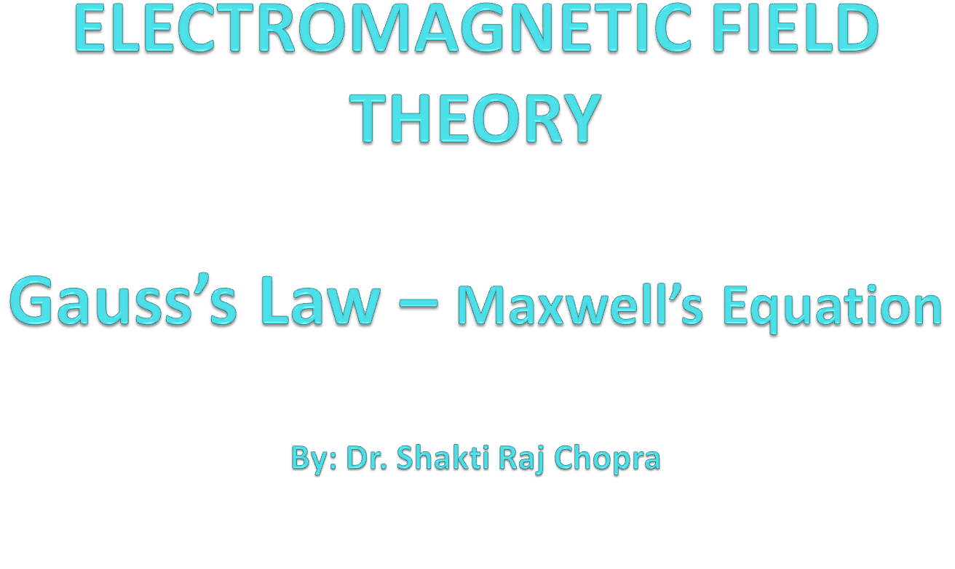

Slide 2
Books
Text Book:
1. PRINCIPLES OF ELECTROMAGNETICS
By - MATTHEW N.O. SADIKU, 4th 2009 OXFORD UNIVERSITY
PRESS, INDIA
Reference Book:
1. ELECTROMAGNETIC WAVES AND RADIATING SYSTEMS
By - EDWARD C. JORDAN 5th PRENTICE HALL

Slide 3
COULOMB'S LAW
Charges are generally measured in coulombs (C). One coulomb is approximately equivalent to 6 X 10^18 electrons; it is a very large unit of charge because one electron charge e = -1.6019 X 10^-19 C.
Coulomb's law states that the force F between two point charges (Q1, and Q2 is:
  1. Along the line joining them
  2. Directly proportional to the product Q1Q2 of the charges
  3. Inversely proportional to the square of the distance R between them

Slide 4
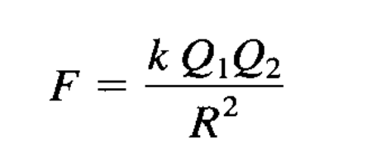
Expressed mathematically,
where k is the proportionality constant. In SI units, charges Q1 and Q2 are in coulombs (C),
the distance R is in meters (m), and the force F is in newtons (N) so that k = 1/4πε0.
The constant ε0 so is known as the permittivity of free space (in farads per meter) and has the value:

Slide 5
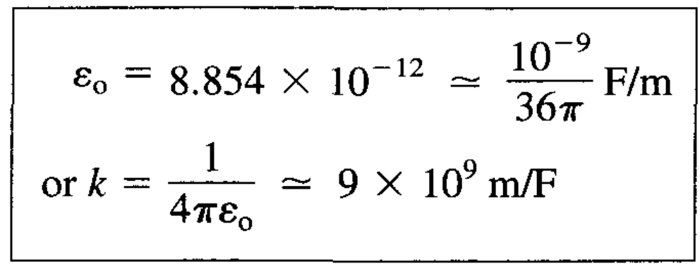
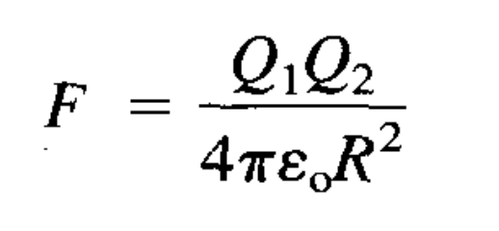
Thus eq. Becomes:

Slide 6
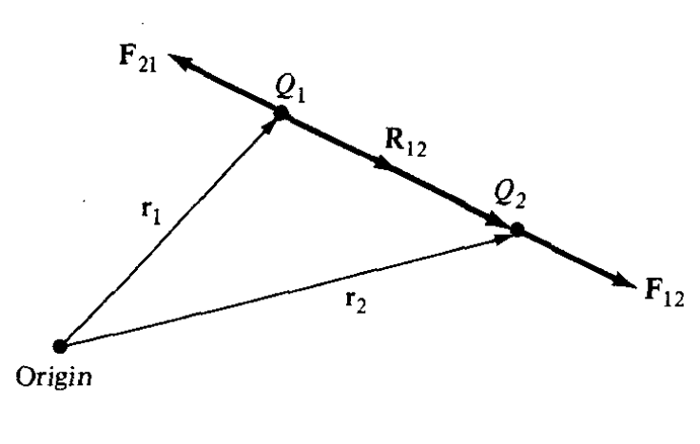
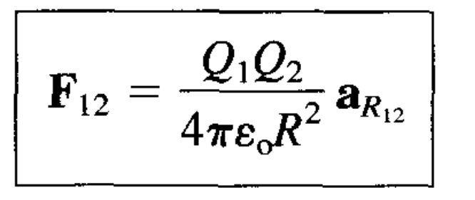
If point charges Q1 and Q2 are located at points having position vectors r1 and r2, then the force F12 on Q2 due to Q1, shown in Figure, is given by

Slide 7
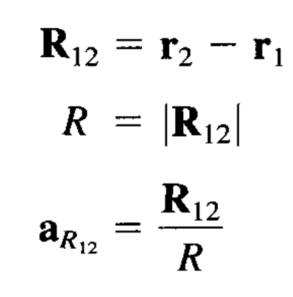
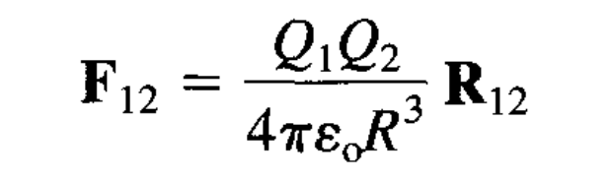
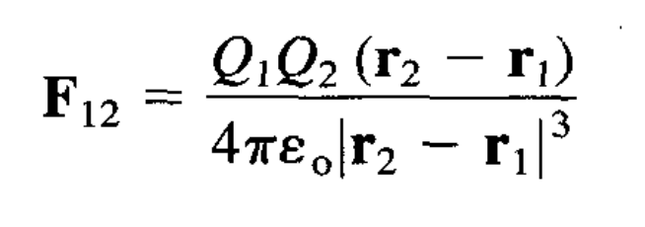
Where
By substituting it in eq.

Slide 8
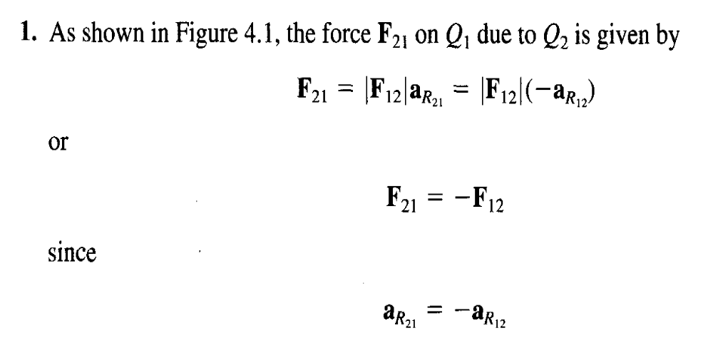

Slide 9
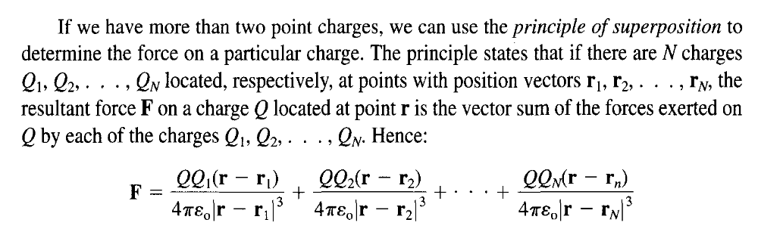
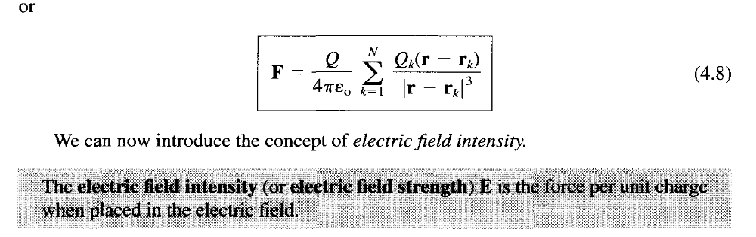

Slide 10
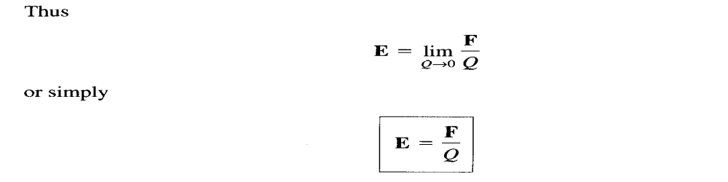
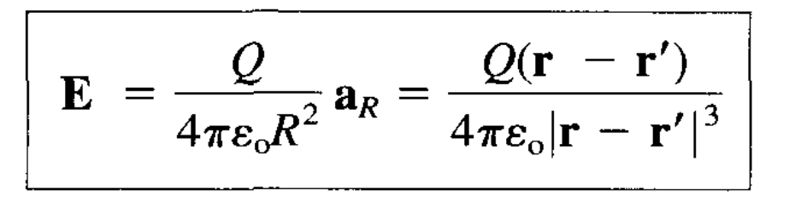
The electric field intensity E is obviously in the direction of the force F and is measured in newtons/coulomb or volts/meter.
The electric field intensity at point r due to a point charge
located at r' is readily obtained as

Slide 11
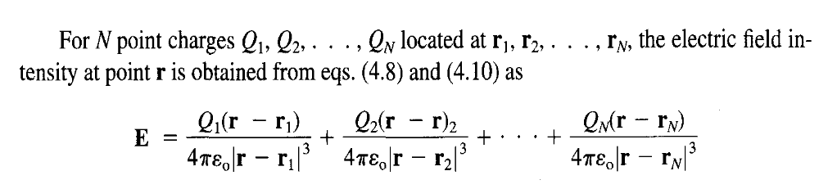
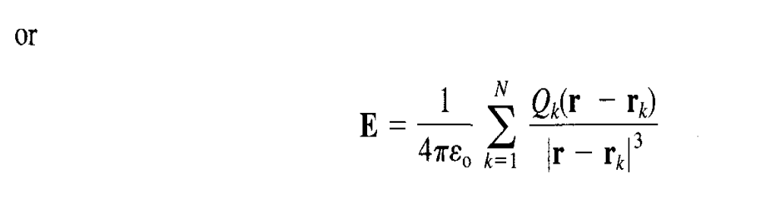

Slide 12
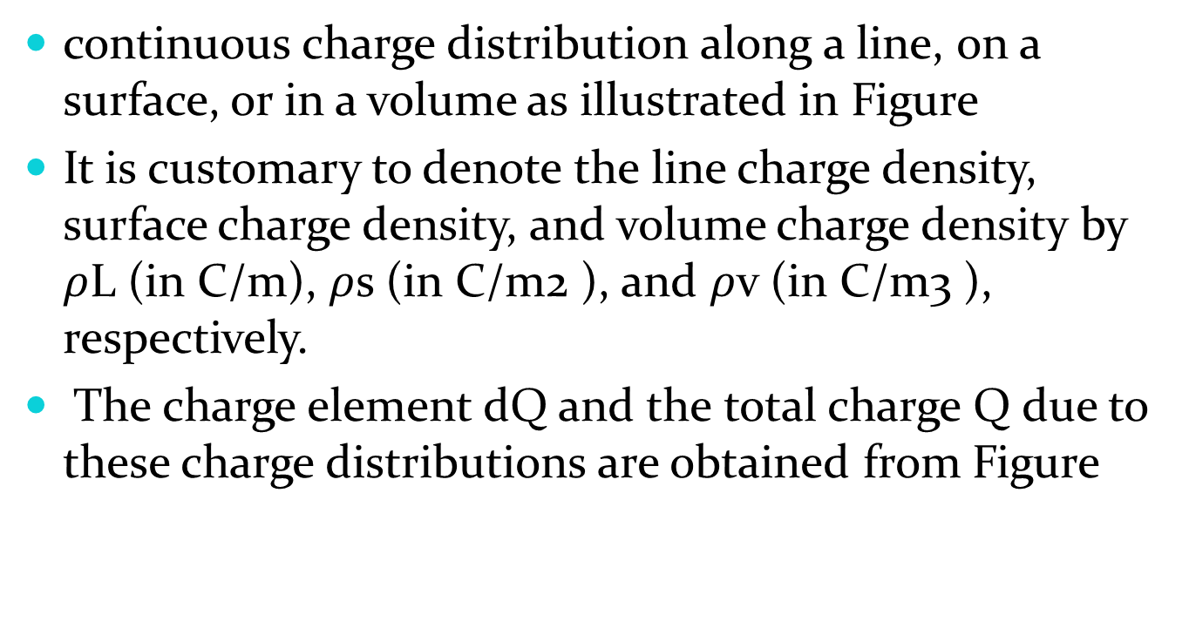
ELECTRIC FIELDS DUE TO CONTINUOUS CHARGE DISTRIBUTIONS

Slide 13
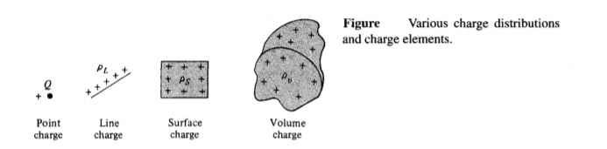

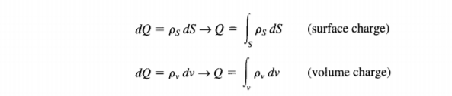

Slide 14
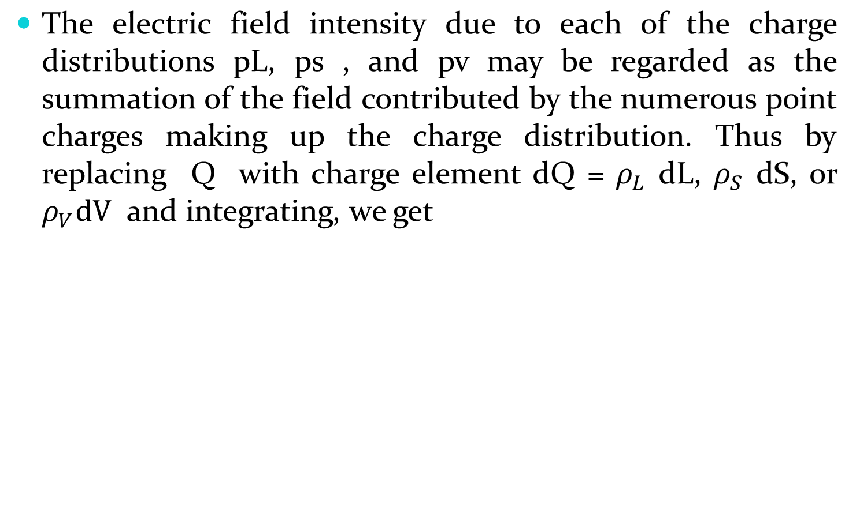
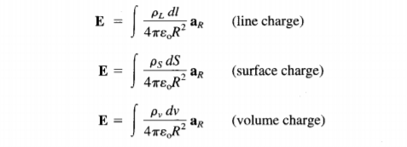

Slide 15
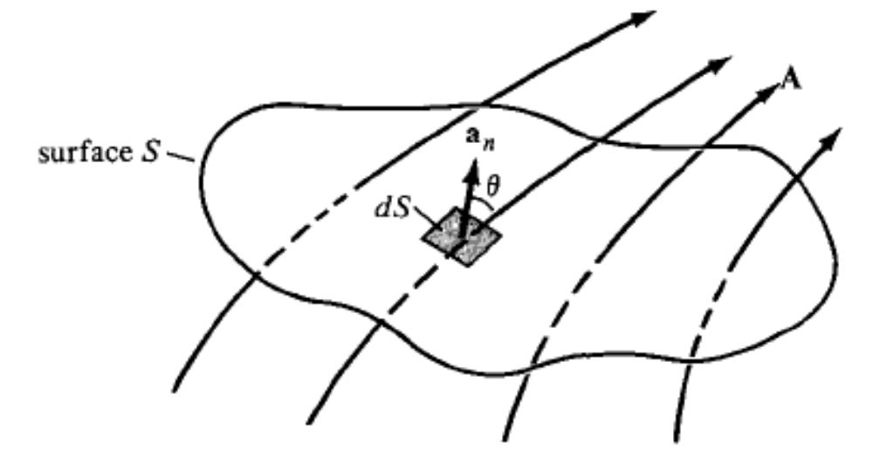
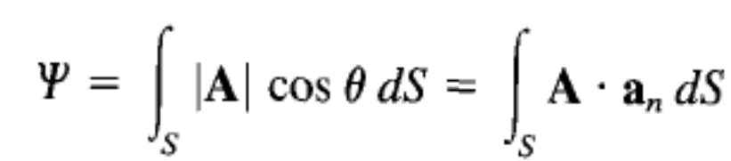
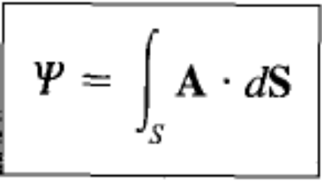
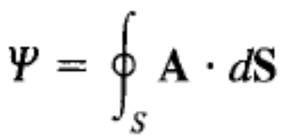
Electric Flux and Flux Density
Given a vector field A, continuous in a region containing the smooth surface S, we
define the surface integral or the flux of A through S
where, at any point on S, an is the unit normal to S. For a closed surface (defining a volume), above eq becomes
which is referred to as the net outward flux of 'A from S.

Slide 16

The flux due to the electric field E can be calculated using the general definition of flux in eq. (3.13). For practical reasons, however, this quantity is not usually considered as the most useful flux in electrostatics. Also, eqs. (4.11) to (4.16) show that the electric field intensity is dependent on the medium in which the charge is placed (free space in this chapter). Suppose a new vector field D independent of the medium is defined by

Slide 17

We define electric flux f in terms of D using eq. (3.13), namely,

Slide 18
Gauss’s Law — MAXWELL'S EQUATION
Karl Friedrich Gauss (1777-1855), a German mathematician, developed the divergence theorem, popularly known by his name.
He was the first physicist to measure electric and magnetic quantities in absolute units.
Gauss's law states that the total electric flux through any closed surface is equal to the total charge enclosed by that surface.

Slide 19

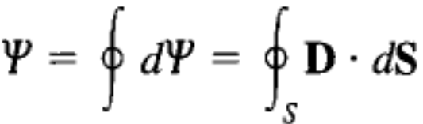
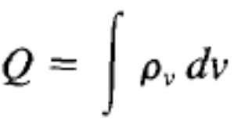
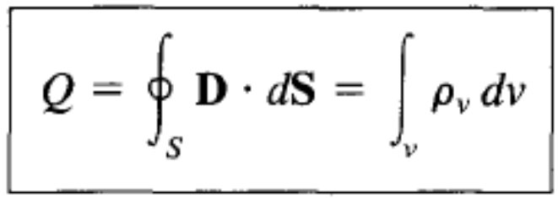
Gauss’s Law — MAXWELL'S EQUATION
Thus
that is,
Total charge enclosed
or

Slide 20
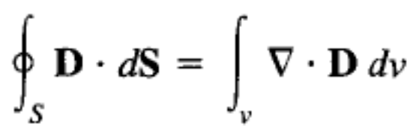
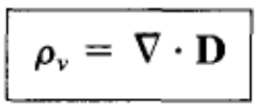
Gauss’s Law — MAXWELL'S EQUATION
By applying divergence theorem
Comparing these two,
which is the first of the four Maxwell's equations.
It also states that the volume charge density is the same as the divergence of the electric flux density.

Slide 21
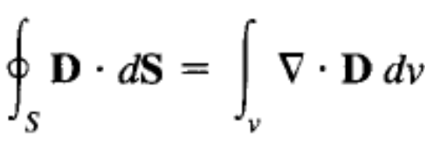
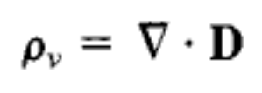
Gauss’s Law — MAXWELL'S EQUATION
Gauss's law in different ways:
The integral form
The differential or point form of Gauss's Law

Slide 22
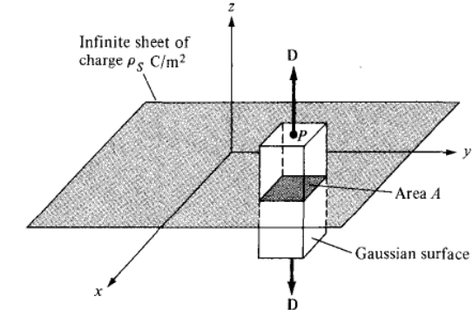
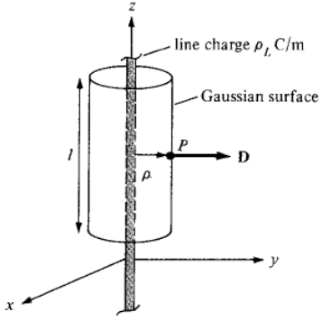
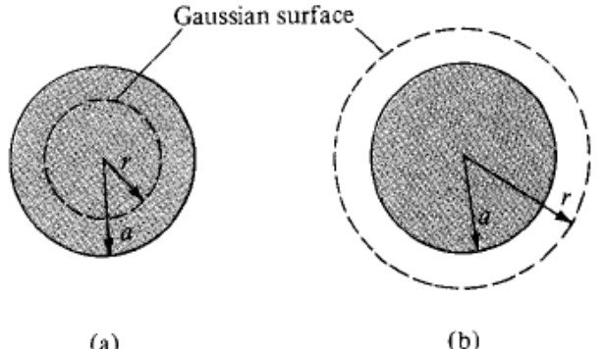
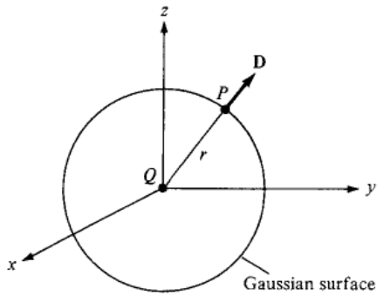
Gauss’s Law — MAXWELL'S EQUATION
Important Observations
A continuous charge distribution has rectangular symmetry if it depends only on x (or y or z), cylindrical symmetry if it depends only on p , or spherical symmetry if it depends only on r (independent of theta and phi).
Rectangular symmetry
Cylindrical symmetry
Spherical symmetry
Spherical symmetry
(Point Charge)

Slide 23
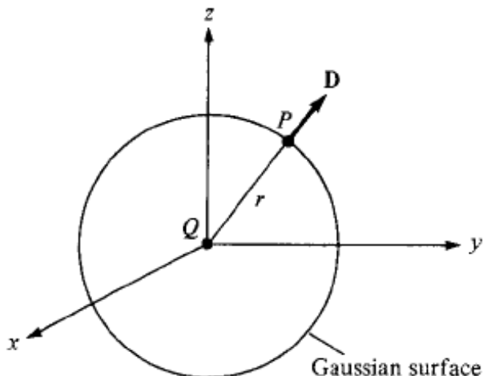
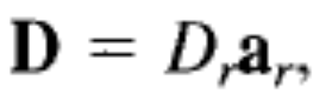
Applications of Gauss’s Law – Point Charge
Suppose a point charge Q is located at the origin. To determine D at a point P, it is easy to see that choosing a spherical surface containing P will satisfy symmetry conditions.
Thus, a spherical surface centered at the origin is the Gaussian surface in this case.
Since D is everywhere normal to the Gaussian surface, that is,

Slide 24

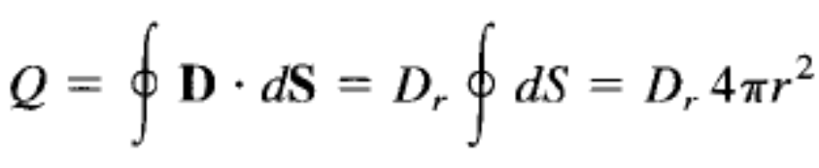
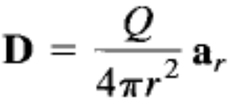
Applications of Gauss’s Law – Point Charge
Applying Gauss's law gives

Slide 25
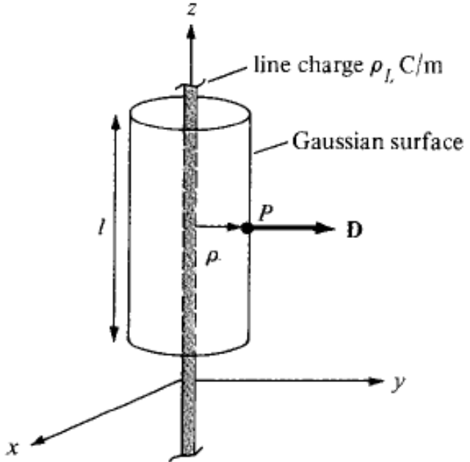


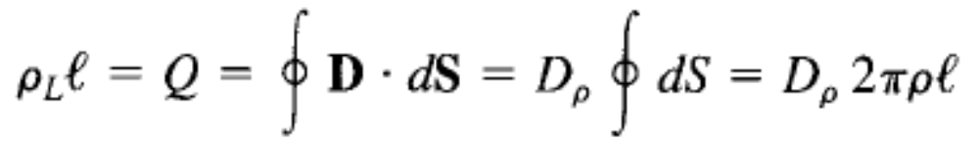
Applications of Gauss’s Law
Infinite Line Charge
Suppose the infinite line of uniform charge lies along the z-axis. To determine D at a point P, we choose a cylindrical surface containing P to satisfy symmetry condition as shown in Figure.
D is constant on and normal to the cylindrical Gaussian surface; that is,

Slide 26

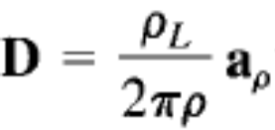
Applications of Gauss’s Law
Infinite Line Charge
If we apply Gauss's law to an arbitrary length € of the line
Note that evaluated on the top and bottom surfaces of the cylinder is zero since D has no z-component; that means that D is tangential to those surfaces. Thus,

Slide 27
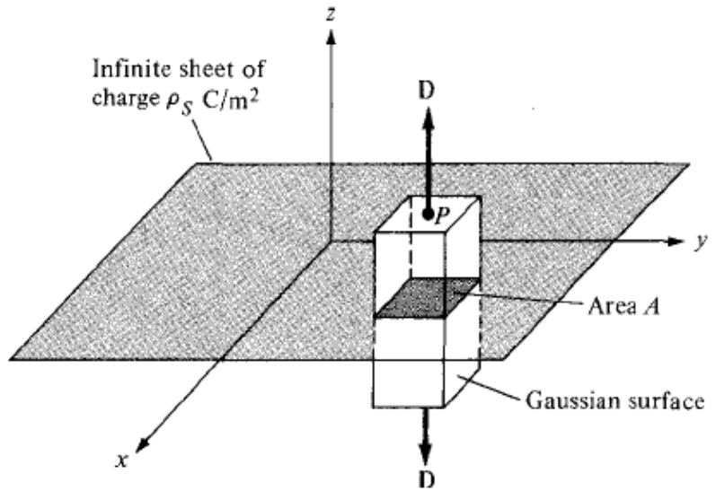


Applications of Gauss’s Law
Infinite Sheet of Charge
Consider the infinite sheet of uniform charge lying on the z = 0 plane.
To determine D at point P, we choose a rectangular box that is cut symmetrically by the sheet of charge and has two of its faces parallel to the sheet as shown in Figure.
As D is normal to the sheet,

Slide 28
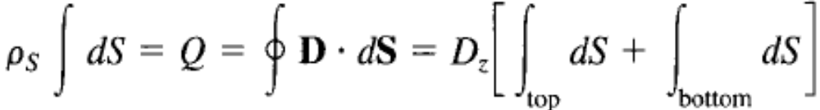

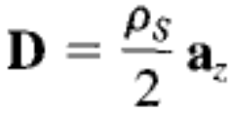
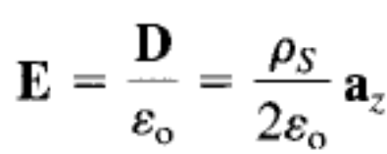
Applications of Gauss’s Law
Infinite Sheet of Charge
Applying Gauss's law gives
Note that D • dS evaluated on the sides of the box is zero because D has no components along ax and ay.
If the top and bottom area of the box each has area A,
Thus,

Slide 29
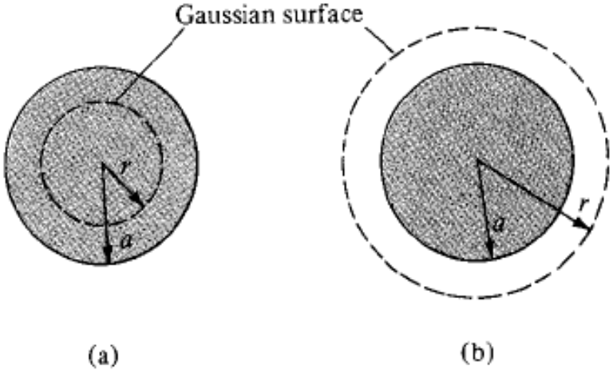


Applications of Gauss’s Law
Uniformly Charged Sphere
Consider a sphere of radius a with a uniform charge
To determine D everywhere, we construct Gaussian surfaces for cases
Since the charge has spherical symmetry, it is obvious that a spherical surface is an appropriate Gaussian surface.

Slide 30
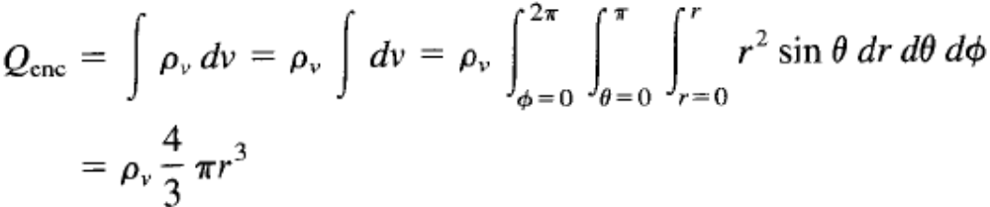
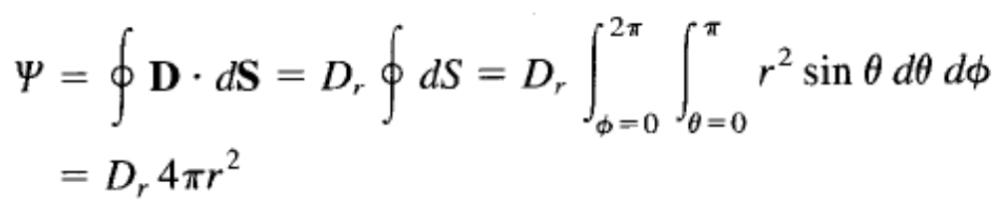
Applications of Gauss’s Law
Uniformly Charged Sphere
For r < a, the total charge enclosed by the spherical surface of radius r,
And

Slide 31



Applications of Gauss’s Law
Uniformly Charged Sphere

Slide 32


Applications of Gauss’s Law
Uniformly Charged Sphere
For r > a, the Gaussian surface is shown in Figure (b). The charge enclosed by the surface is the entire charge in this case, that is,
while

Slide 33




Applications of Gauss’s Law
Uniformly Charged Sphere
or
D everywhere is given by

Slide 34


